Slide 1

What's new in Android ?

Slide 2

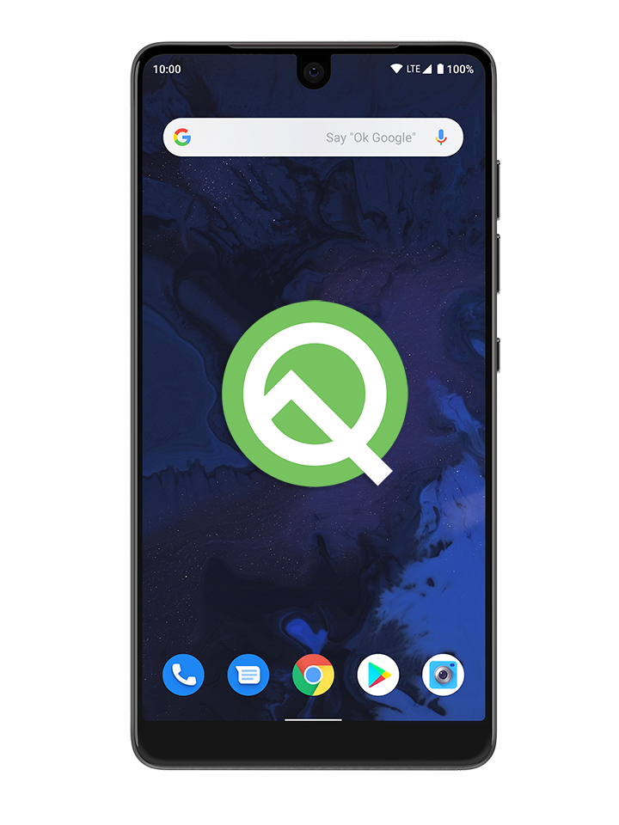
Android Q (10)
Notes:
Native support for 5G.

Slide 3
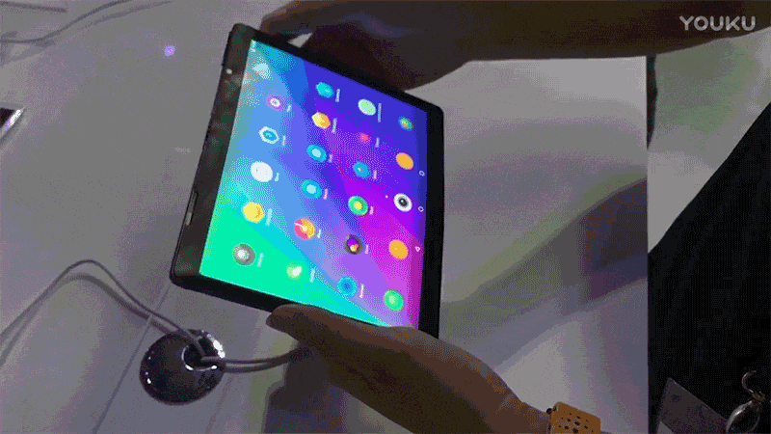
Foldable support

Slide 4
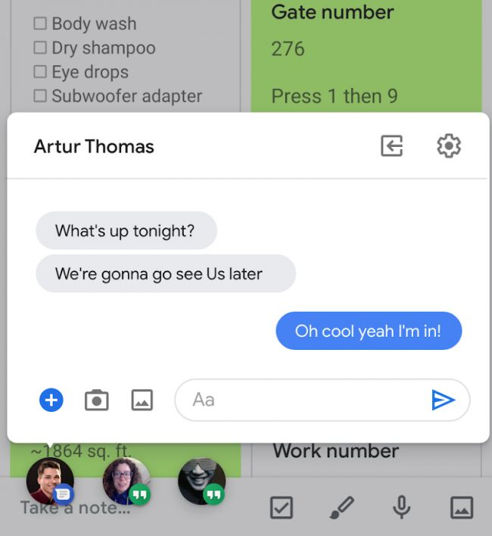
Android Q 'bubbles' multitasking

Slide 5
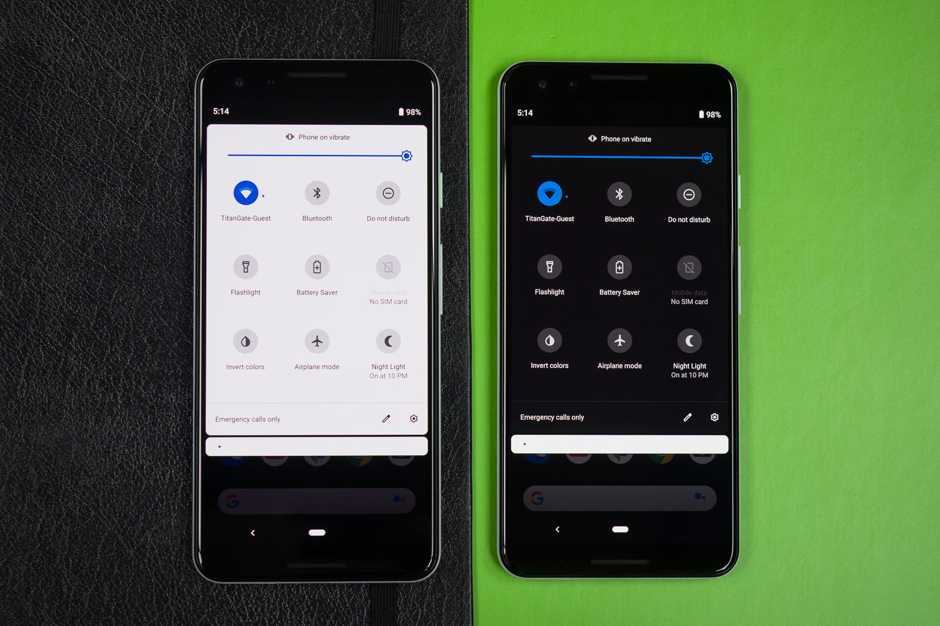
Dark Theme, the system-wide dark mode

Slide 6
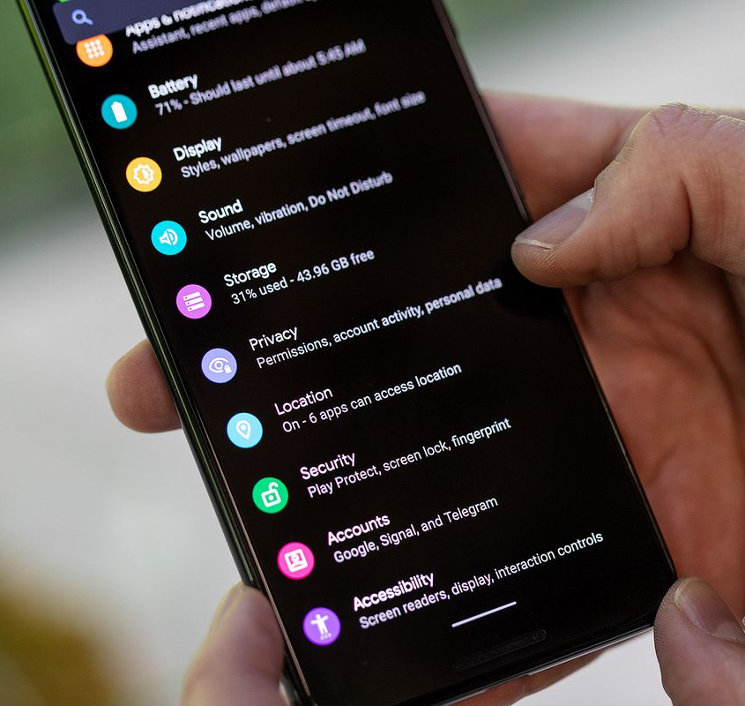
New Android Q privacy features
more controle over app access to permissions (reminder).
appmakers can opt to send high-priority notifications first.
security updates in the background.
Notes:
Users will have more control over app access to location info, shared files and repositories like Photos and Videos.
Another helpful change: instead of apps automatically switching focus when they have an Activity in the background (like an alarm or call), .
Scoped Storage – which allows users to control how apps access external storage (say, in a MicroSD card). It will also better protect users from being identified by restricting access to non-resettable device identifiers, like your phone's serial number and/or IMEI, and randomizing its MAC address when connected to different Wi-Fi networks.

Slide 7
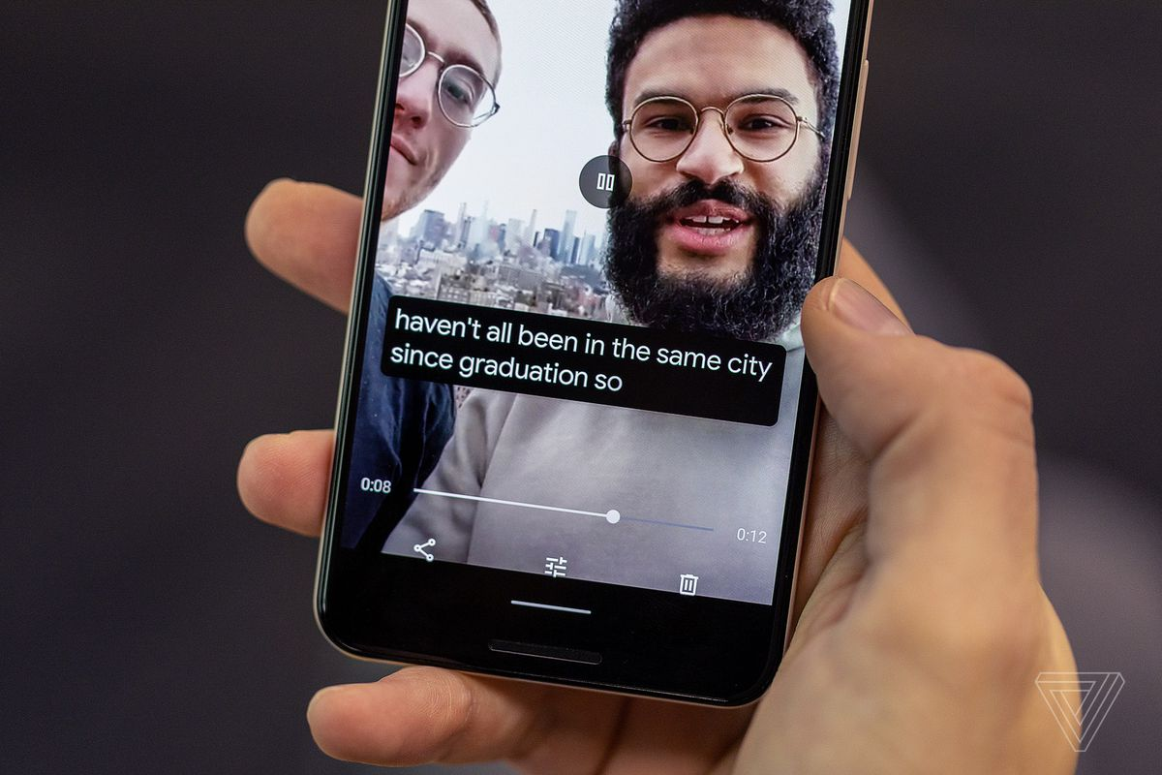
Live Caption
Notes:
Live Caption, which can automatically create captions for audio and videos. The feature can be used offline.
NLP without network
Project Euphonia

Slide 8

Project Euphonia

Slide 9
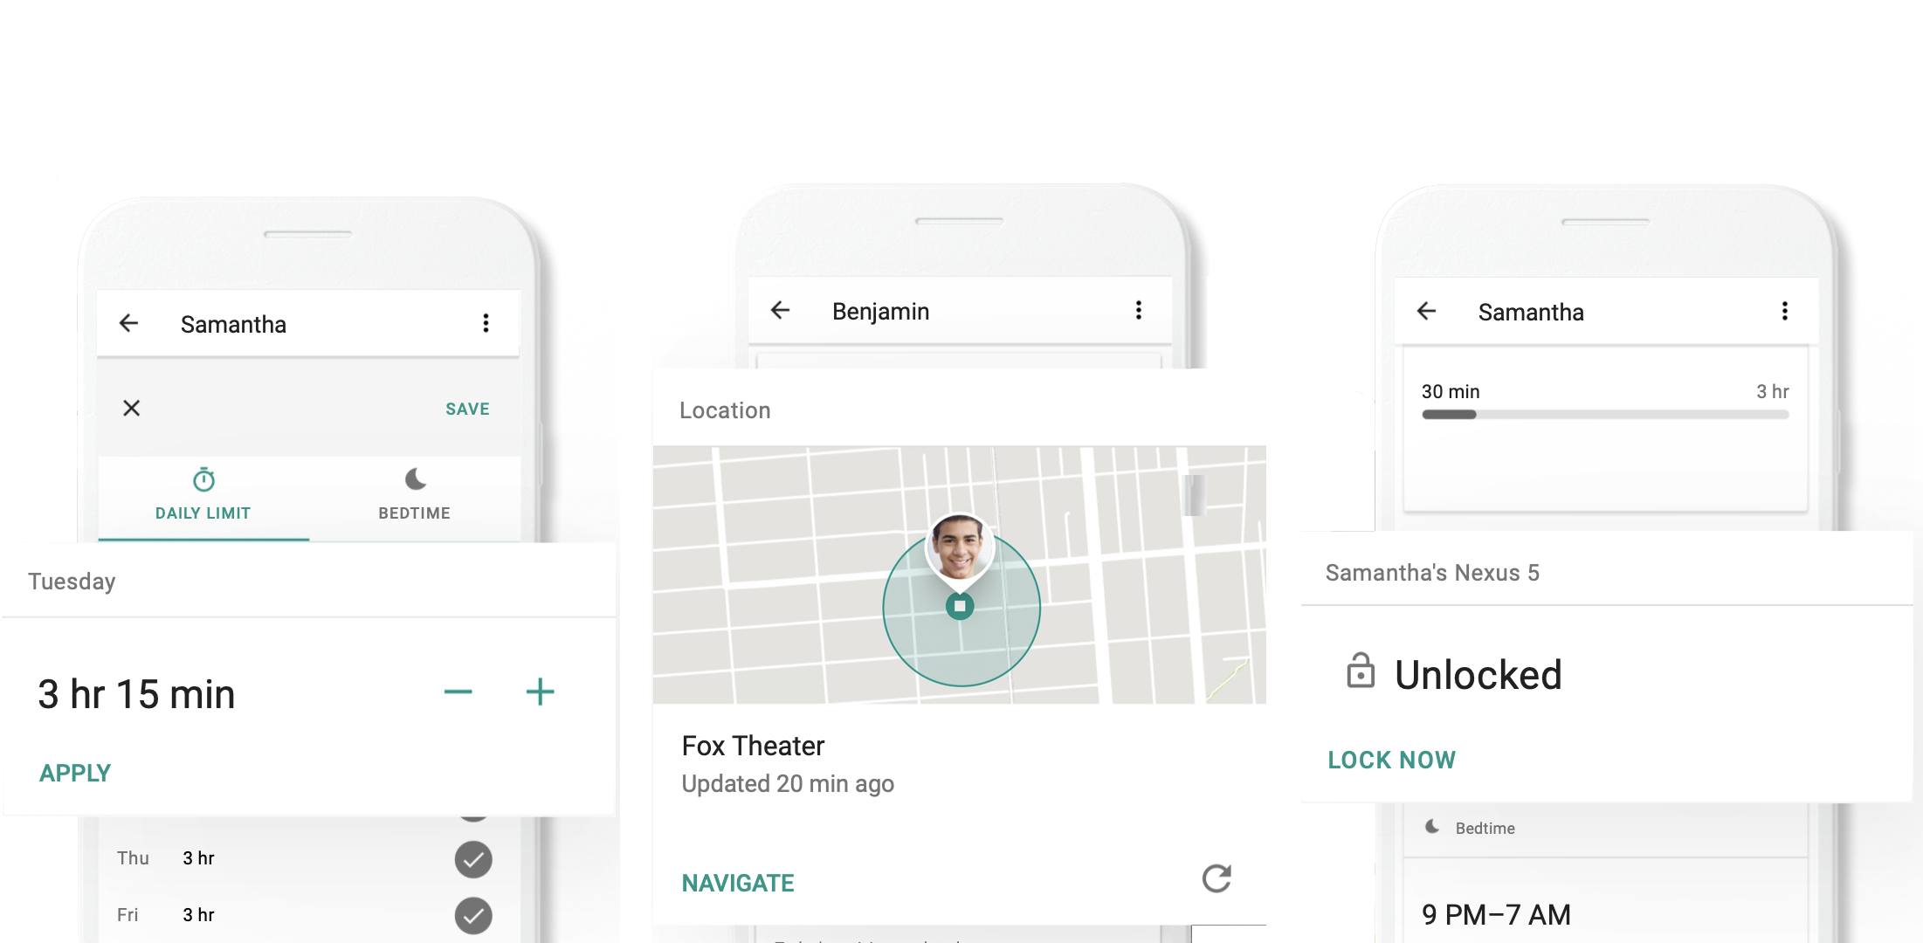
Family Link

Slide 10
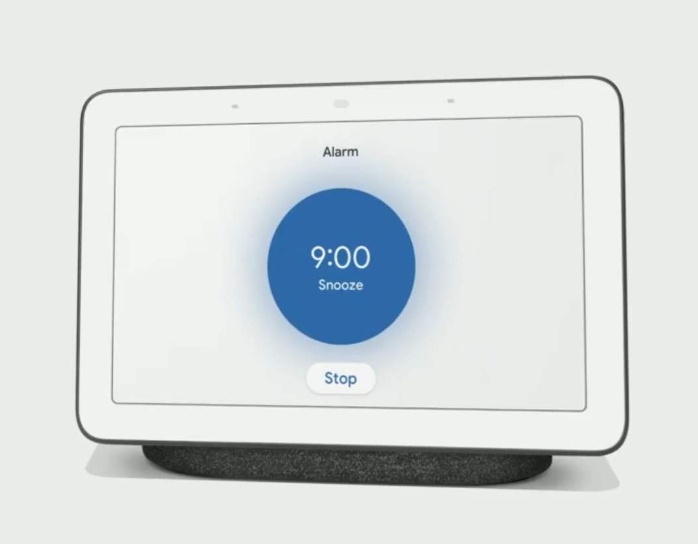
Alarm stop by voice

